Slide 1


Social Buzz
Notes:
Hey Everyone, My Name is Ishant Kumar and I am a data analyst. I will be walking you through this presentation and explaining some valuable insights on social buzz.

Slide 2


Today's agenda
Project recap
Problem
The Analytics team
Process
Insights
Summary
Notes:
Let’s take a look at what we will be covering in this presentation.
Project Recap where we will have Brief revisit on the project objectives and what we were set out to achieve.
Problem where I will Highlight the main challenge or issue that prompted our analysis.
The Analytics Team: I will Introduce you to the members of the analytics team involved in the project.
Process: I will Outline the steps we followed in our analysis and data exploration.
Insights: where I will be sharing the key findings and insights we uncovered and a Summary

Slide 3

Social Buzz is a fast growing technology unicorn that need to adapt quickly to it's global scale.
Accenture has begun a 3 month POC Focusing on these tasks:
An audit of Social Buzz's big data practice
Recommendations for a successful IPO
Analysis to find Social Buzz's top 5 most popular categories of content
Project Recap
Notes:
Social Buzz, a rapidly expanding technology unicorn, faces the challenge of scaling its operations globally. To navigate this growth and prepare for a potential Initial Public Offering (IPO), Accenture has initiated a three-month Proof of Concept (POC). The primary objectives of this POC are:
Conduct an audit of Social Buzz's big data practices to assess their current capabilities and identify areas for improvement.
Provide recommendations for a successful IPO, leveraging insights from data analysis and market trends.
Perform analysis to determine Social Buzz's top 5 most popular categories of content, enabling the company to capitalize on its vast volume of user-generated content.

Slide 4

Problem
Over 100,000 posts per day
36,500,000 pieces of content per year!
But how to capitalize on it when there is so much?
Analysis to find Social Buzz's top 5 most popular categories of content
Notes:
Social Buzz generates an overwhelming amount of content, with over 100,000 posts per day and a staggering 36,500,000 pieces of content annually. This presents a significant challenge in effectively harnessing and monetizing this content due to its sheer volume and diversity.

Slide 5



Andrew Fleming
Chief Technical Architect
The Analytics team
Marcus Rompton
Senior Principle
Ishant Kumar
Data Analyst
Notes:
I would like to introduce you to the analytics team. We have Andrew Fleming as The Chief Technical Architect, Marcus Rompton as Senior Principle and myself Ishant Kumar as Data analyst

Slide 6
Process
1
Data Understanding
2
Data Cleaning
3
Data Modelling
4
Data Analysis
5
Uncover Insights
Notes:
Let's explore our data analysis process:
1. Data Understanding:
We began by thoroughly understanding our dataset, examining its structure, format, and content to identify key attributes and variables. This laid the foundation for our analysis.
2. Data Cleaning:
Next, we cleaned the data to ensure accuracy, consistency, and completeness. This involved addressing issues like missing values, duplicates, outliers, and formatting inconsistencies to prepare the data for analysis.
3. Data Modelling:
With a cleaned dataset, we applied statistical and machine learning techniques to uncover patterns, relationships, and trends. This included building predictive models and clustering algorithms to extract insights.
4. Data Analysis:
We conducted in-depth analysis to interpret results, evaluating performance metrics and identifying significant findings or correlations. This helped us gain valuable insights into underlying patterns and drivers.
5. Uncover Insights:
Finally, we synthesized our findings into actionable insights, translating complex results into clear, understandable insights. This empowered stakeholders to make informed decisions and capitalize on opportunities.
In summary, our data-driven approach involved understanding, cleaning, modeling, analyzing, and uncovering insights from our data to drive meaningful impact for our organization.

Slide 7

Insights
16
Unique Categories
Animal
Most Favourite Category
May
with most number of Posts
Notes:
We have 16 unique categories out of which Animal is the most favourite category and May was the month with the most number of posts

Slide 8
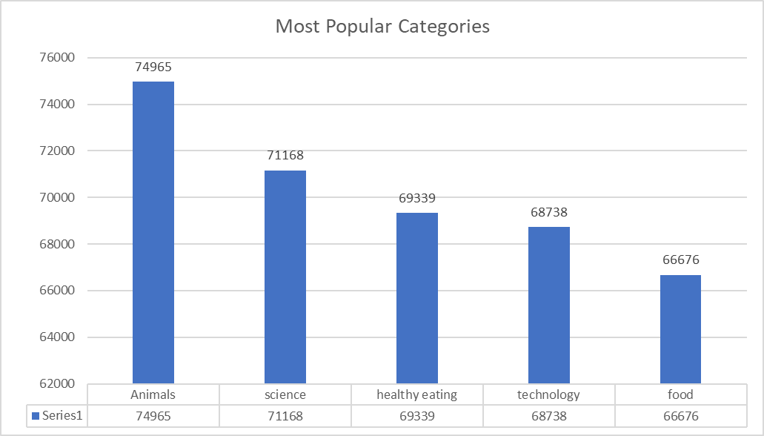
Notes:
We have the top 5 most popular categories. First we have Animals that has count of 74965 posts, then Science with 71168 posts and Healthy Eating with 69339 posts. Then comes Technology and Food with 68738 posts and 66676 posts each.

Slide 9
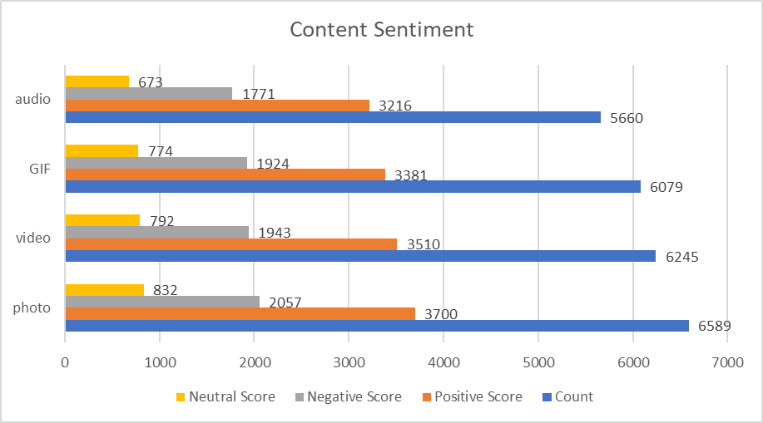

Slide 10

There are a total of 16 distinct content categories. Out of which Animal and Science are the most popular one.
4 Types of content – Photo, Video, GIF and Audio, out of which people prefer photo and video the most.
May Month has the highest number of posts and stands at 2138 posts, while February month has the lowest number off posts (1914 Posts).
Conclusion
Social Buzz should focus more on the top 5 categories that’s Animal, Technology, Science, Healthy eating and food and can create a campaign to specifically target those audiences.
Social Buzz can need to maximize in the month of January, May and August as the number of posts in these months are the highest.
Summary
Notes:
In our analysis of Social Buzz's content data, we discovered several key insights that can inform strategic decisions moving forward.
We identified a total of 16 distinct content categories, with Animal and Science emerging as the most popular ones among users.
Among the four types of content – Photo, Video, GIF, and Audio – our analysis revealed that people prefer photo and video content the most.
When examining post frequency by month, we found that May had the highest number of posts, totaling 2138, while February had the lowest, with 1914 posts.
Conclusion:
In light of these findings, Social Buzz should consider focusing its efforts on the top 5 categories: Animal, Technology, Science, Healthy Eating, and Food. By tailoring content and campaigns to these categories, Social Buzz can better engage with its audience and drive user engagement.
Additionally, our analysis highlights the importance of maximizing efforts during peak posting months. Specifically, Social Buzz should capitalize on the high post volumes in January, May, and August to maximize reach and impact.
By leveraging these insights, Social Buzz can enhance its content strategy, optimize audience targeting, and ultimately drive growth and success in the dynamic world of social media.

Slide 11
Thank you!
ANY QUESTIONS?

